Slide 1
facebook

Slide 2
John Nowlin
College Center for Library Automation
N
N

Slide 3
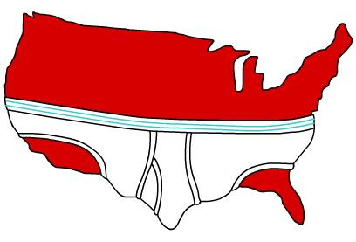
CCLA
28 Florida community colleges
70+ campuses
http://www.homestarrunner.com/sbemail34.html

Slide 4
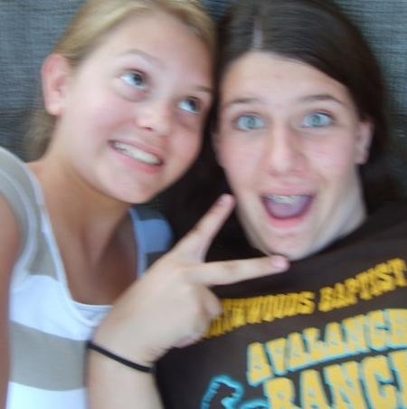
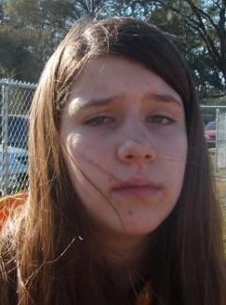
facebook

Slide 5
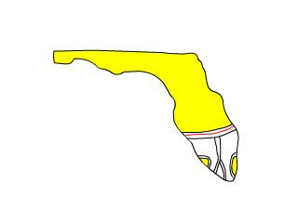
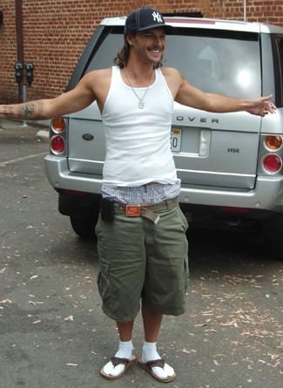
facebook
/
myspace
=
=
http://www.homestarrunner.com/sbemail34.html
http://i.ivillage.com/E/325/BritneyOops/E_BritMarriage_325.jpg

Slide 6
facebook
application

Slide 7
YAPL
fbml
fbjs
fbcanvas

Slide 8
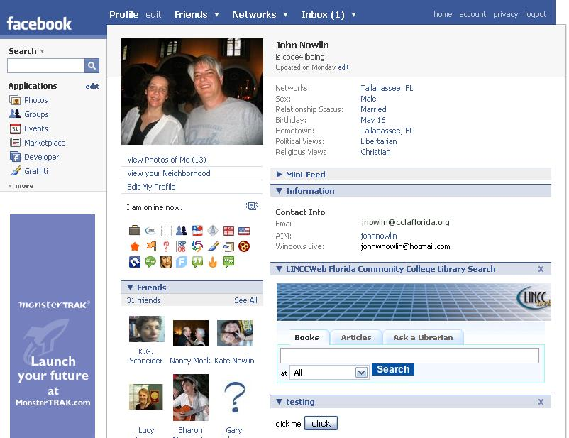
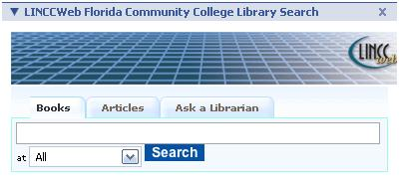

Slide 9


jnowlin@cclaflorida.org

